Slide 1
Review of Set Theory
Probability theory is grounded in set theory
Union
Intersection
Compliment
De Morgan’s Law

Slide 2
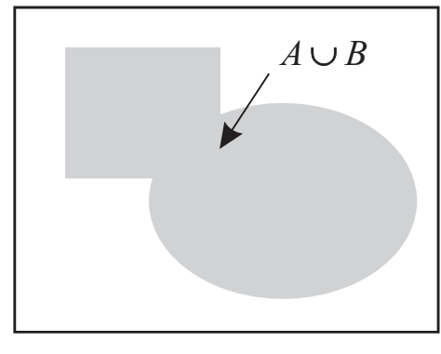
Set Union

Slide 3
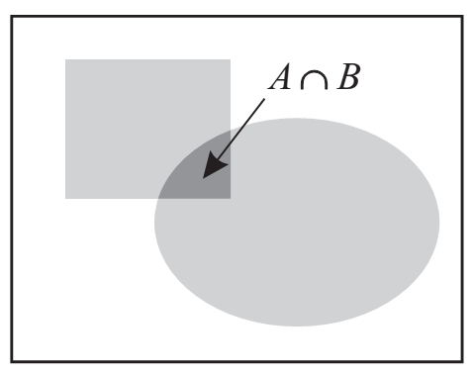
Set Intersection

Slide 4
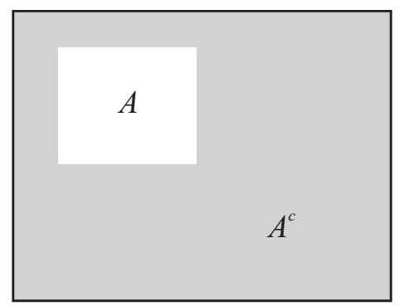
Set Compliment

Slide 5
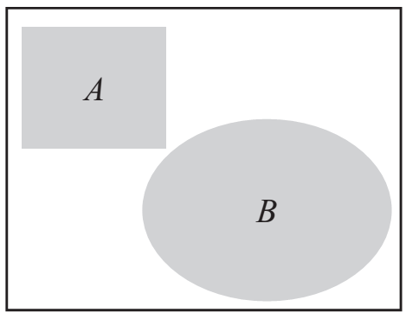


Mutually Exclusive (Disjoint)

Slide 6
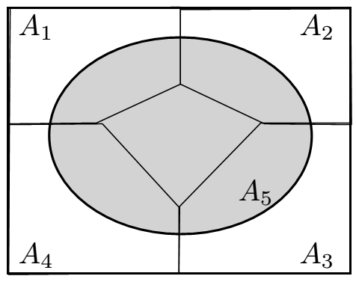
Collectively Exhaustive

Slide 7


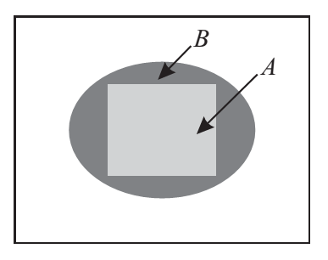

Other Basic Definitions
means if then

Slide 8
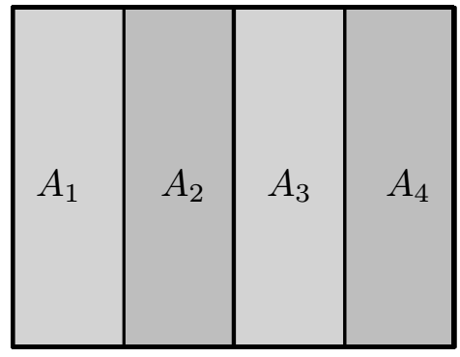
Partition
Both mutually exclusive AND collectively exhaustive

Slide 9

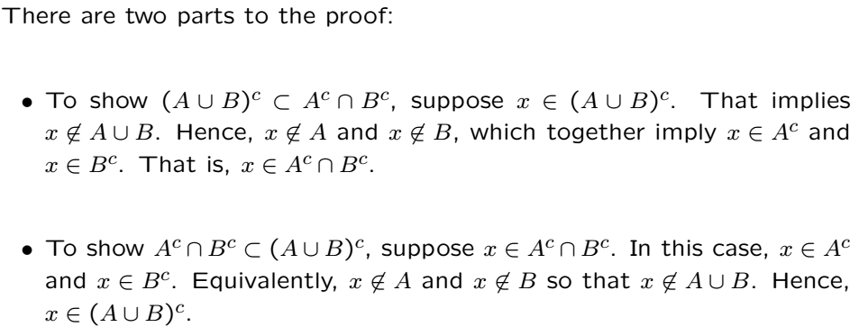
De Morgan’s Law

Slide 10
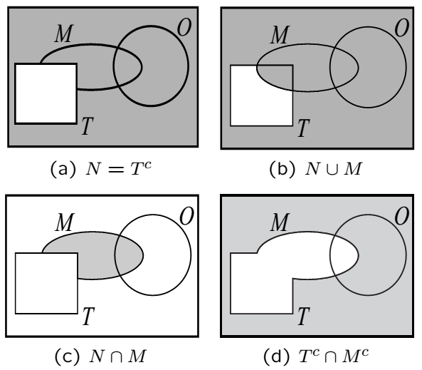
Example

Slide 11
Acknowledgements and Citations
Parts of these slides are adapted from the following resources:
Power Point Lecture Slides for the Textbook http://bcs.wiley.com/hebcs/Books?action=index&bcsId=8676&itemId=1118324560
John Tsitsiklis. 6.041 Probabilistic Systems Analysis and Applied Probability, Fall 2010. (Massachusetts Institute of Technology: MIT OpenCourseWare),http://ocw.mit.edu (Accessed 13 Apr, 2015). License: Creative Commons BY-NC-SA

